Slide 1


Social Buzz
Analytics
Presented by Dinar Wahyu Rahman

Slide 2


Today's agenda
Project recap
Problem
The Analytics team
Process
Insights
Summary

Slide 3

Social Buzz is a fast-growing technology unicorn that needs to adapt quickly to its global scale. To start our engagement with Social Buzz, we are running a 3-month initial project to prove to them that we are the best firm to work with.
They are expecting the following:
An audit of their big data practice
Recommendations for a successful IPO
An analysis of their content categories that highlights the top 5 categories with the largest aggregate popularity.
Project Recap

Slide 4

Problem
Analysis to find the top 5 categories of content in Social Buzz.
Every 100.000 pieces of content per day. How do we capitalize on it when there is so much?

Slide 5



Andrew Fleming
Chief Technical Architect
The Analytics team
Marcus Rompton
Senior Principle
Dinar W. Rahman
Data Analyst

Slide 6
Process
1
Data Understanding
2
Data Cleaning
3
Data Modelling
4
Data Analysis
5
Uncover Insight

Slide 7

Insights
17
1368
August
UNIQUE CATEGORIES
REACTION TO “Travel”
POST
MONTH WITH THE MOST POSTS

Slide 8
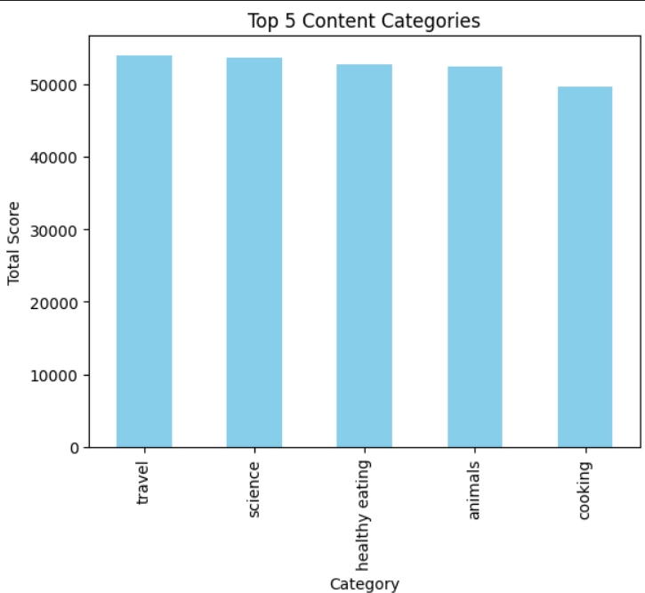
Top 5 Categories by aggregate ‘Popularity” score

Slide 9
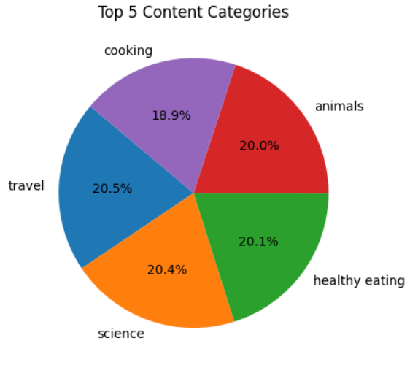
Popularity percentage share from top 5 categories

Slide 10

ANALYSIS
Travel and Science are two popular content categories, with people showing interest in holidays and science.
INSIGHT
Cooking is a common theme that is included in the top 5 categories with “Healthy Eating”. This indicates that the audience is within the user base. You can use this insight to create campaigns and work with chefs to share healthy food recipes to boost user engagement.
Summary
NEXT STEPS
These ad-hoc analyses provide deep insights, but it's time to take them into large-scale production to understand your business in real-time. We can show you how to do this.

Slide 11
Thank you!
ANY QUESTIONS?
Presented by Dinar Wahyu Rahman

